Slide 1
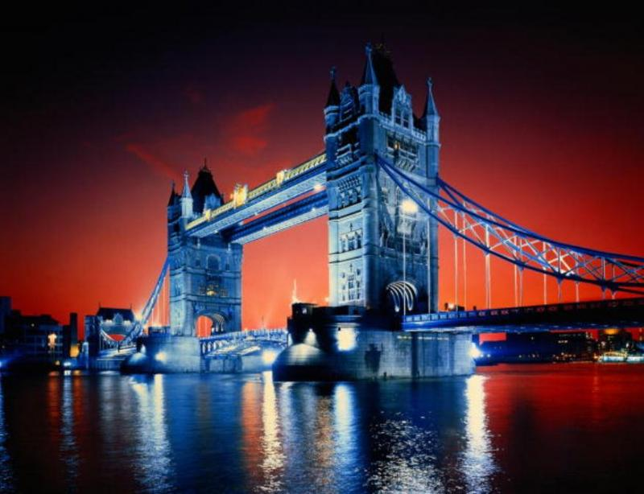
Great Britain

Slide 2
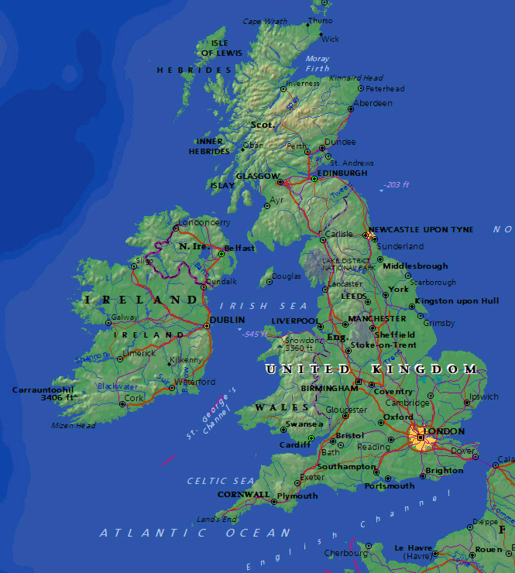
The United Kingdom of Great Britain and Northern Irelands is situated on the British Isles.
The British Isles consists of two large islands, Great Britain and Ireland, and about five thousand small islands.
Their total area is over 244,000 square kilometers.

Slide 3
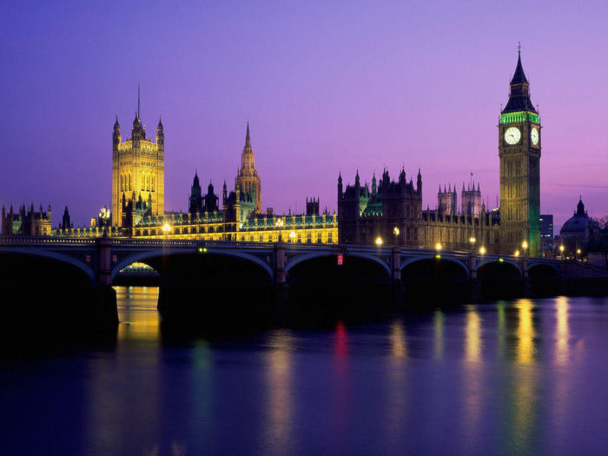
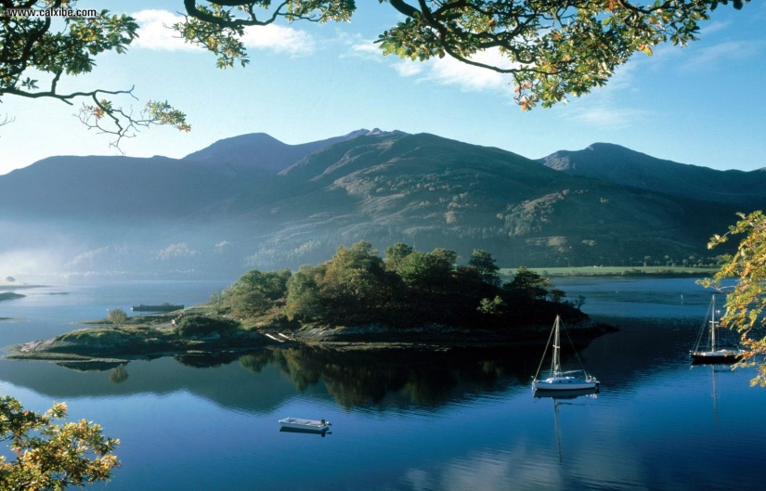
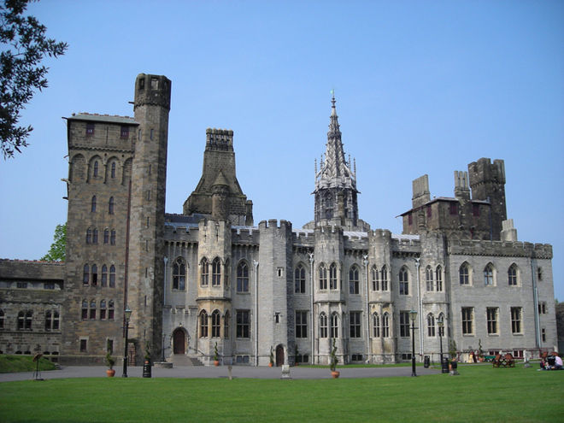
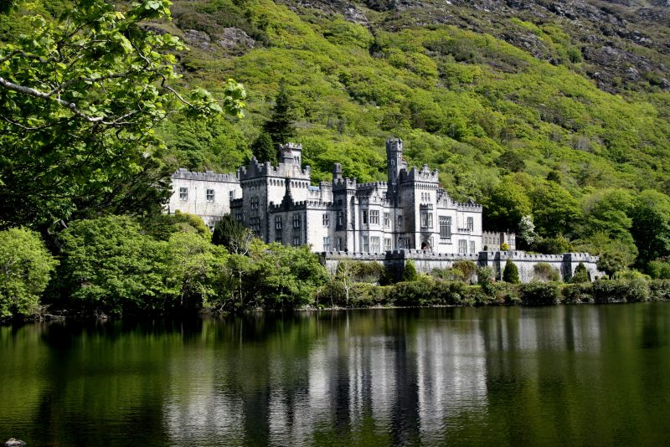
The UK includes four countries: England, Wales, Scotland and Northern Ireland. Great Britain consists of England, Scotland and Wales and doesn't include Northern Ireland.

Slide 4
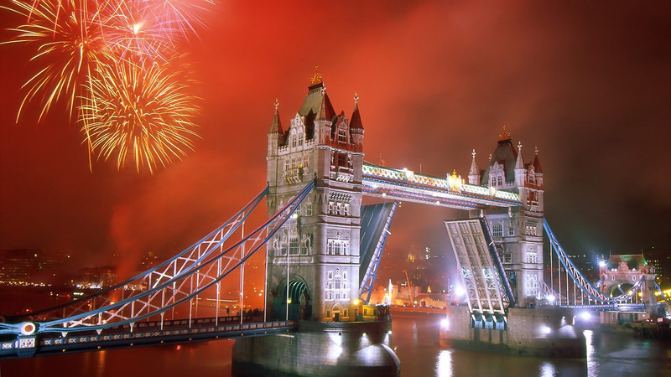
The capital of the UK is London.

Slide 5
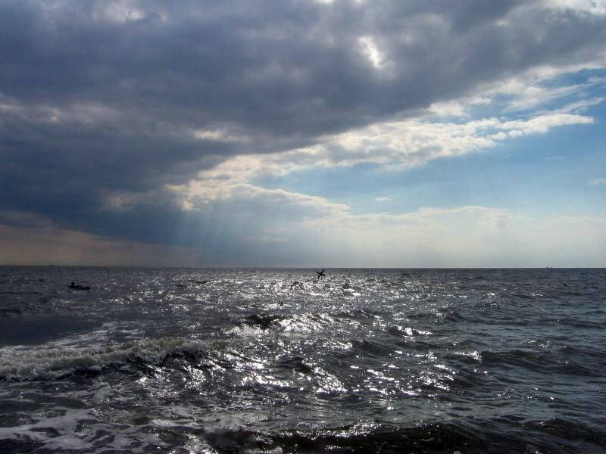
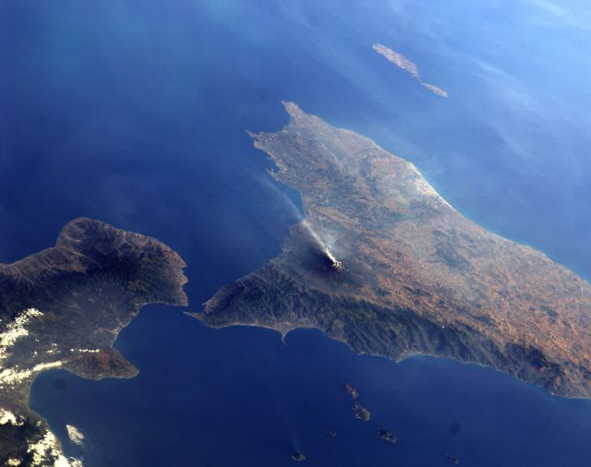
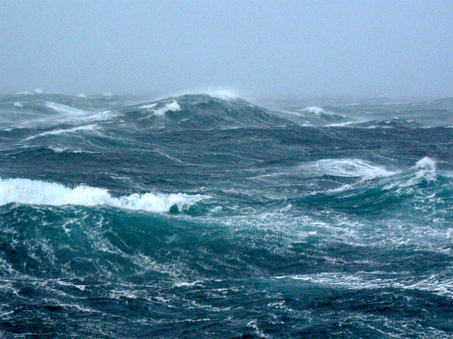
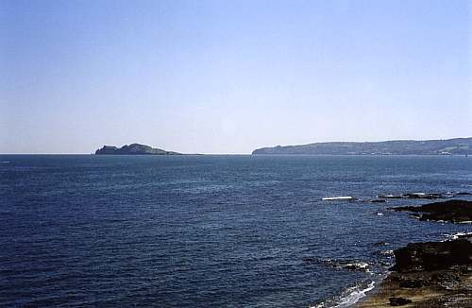
The British Isles are separated from European continent by the North Sea and the English Channel. The western coast of Great Britain is washed by the Atlantic Ocean and the Irish Sea.

Slide 6
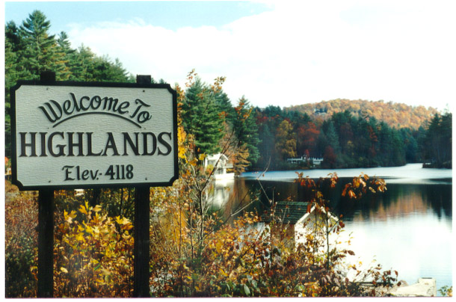
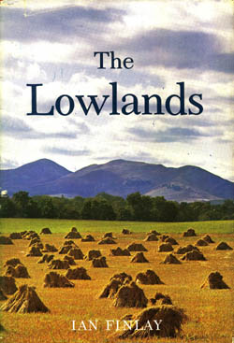
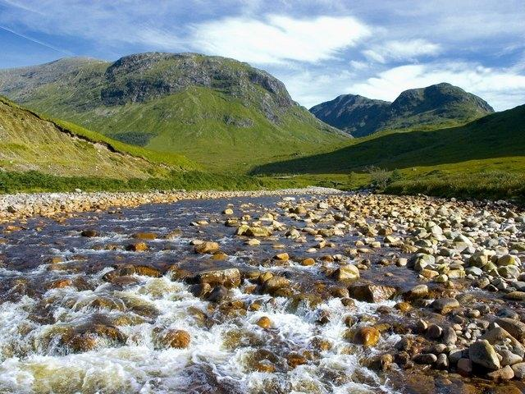
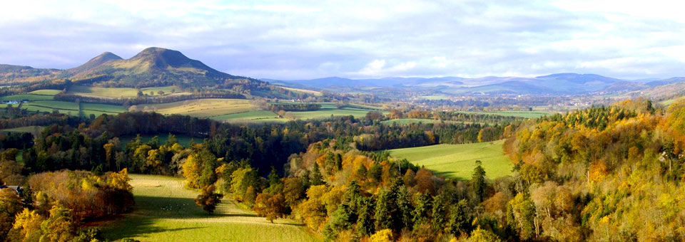
The surface of the British Isles varies very much. The north of Scotland is mountainous and is called the Highlands, the south, which has beautiful valleys and plains, is called the Lowlands.

Slide 7
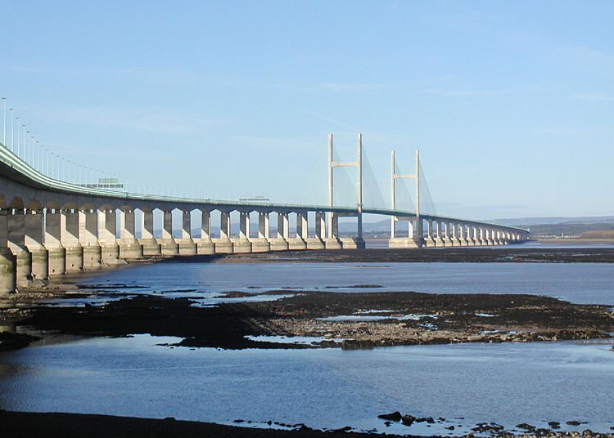
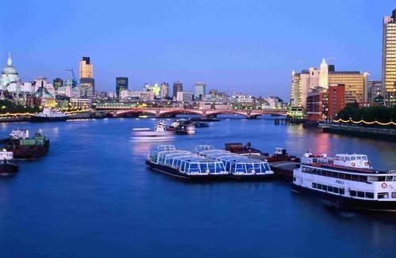
There are a lot of rivers in Great Britain, but they are not very long.
The Severn is the longest river,
while the Thames is the deepest and the most important one.

Slide 8
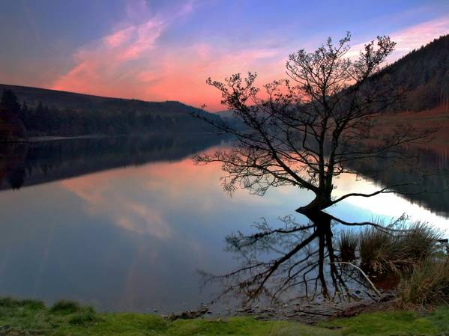
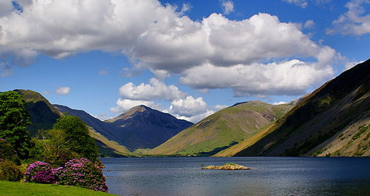
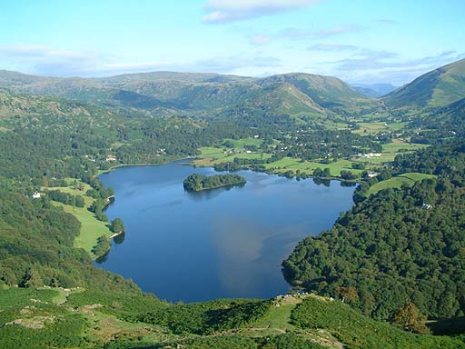
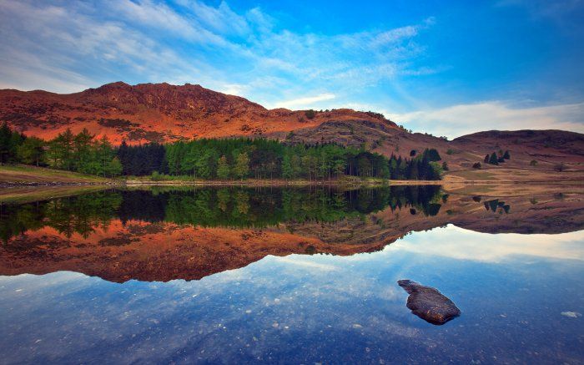
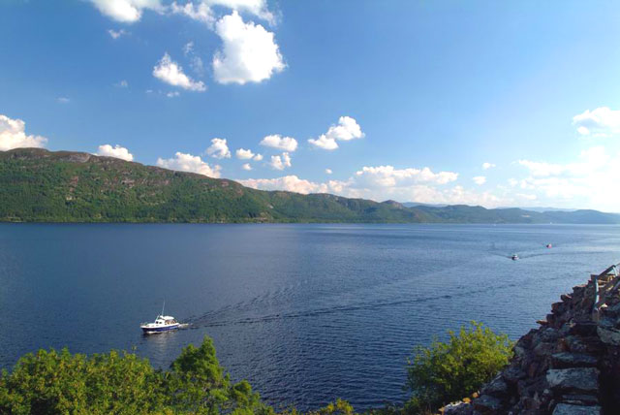
There are many lakes in Great Britain .

Slide 9
Big Ben
Big Ben (English Big Ben.) is the Bell tower in London, the part of the architectural complex of the Palace of Westminster
Big Clock of Westminster is the second largest in the world
You can see the Latin inscription «Domine Salvam fac Reginam nostram Victoriam primam» ( «God save our Queen Victoria the First")

Slide 11
The Tower
The Tower is a fortress, standing on the north bank of the Thames, it is also the historic center of London, one of the oldest buildings in England and one of the main symbols of the UK.
The Tower ravens are not just birds. They are the most important and mysterious symbols of the British Empire.
According to ancient legend if the ravens fly , the Tower will be collapsed . They are respected by all the British. Each of birds has its own name.

Slide 12
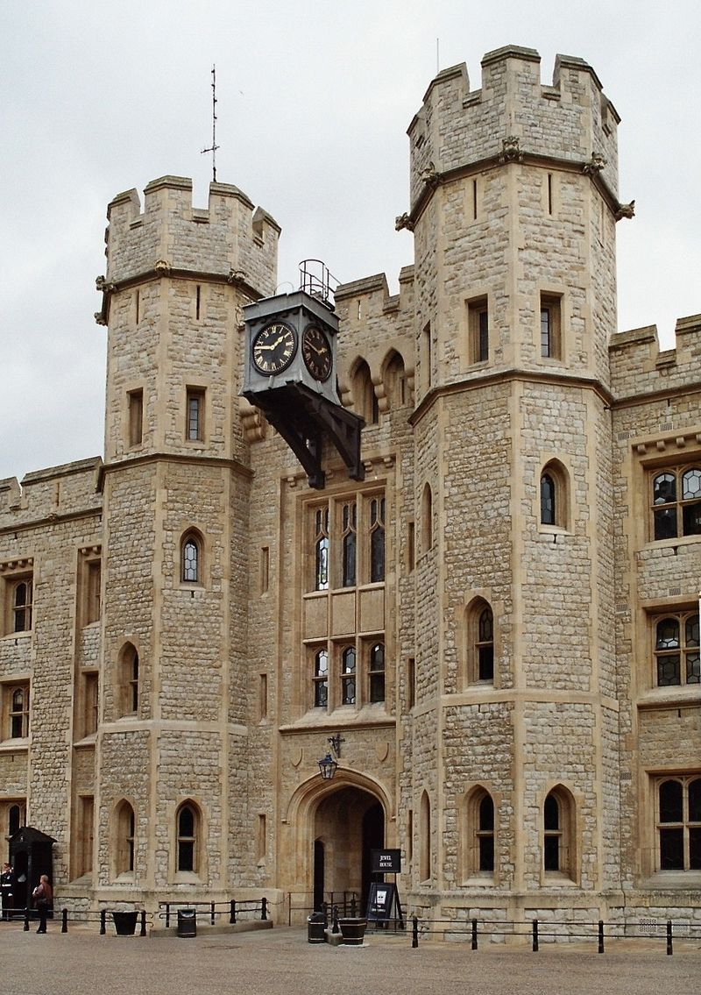
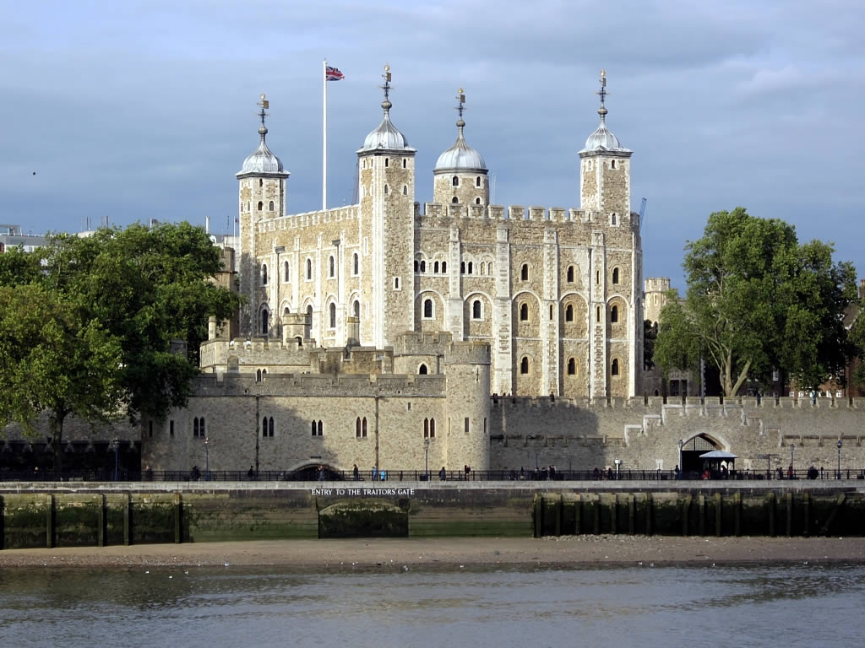

Slide 13
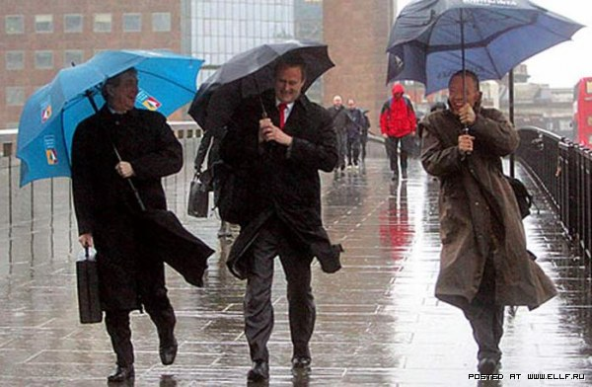
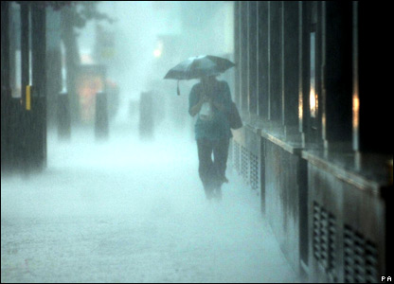
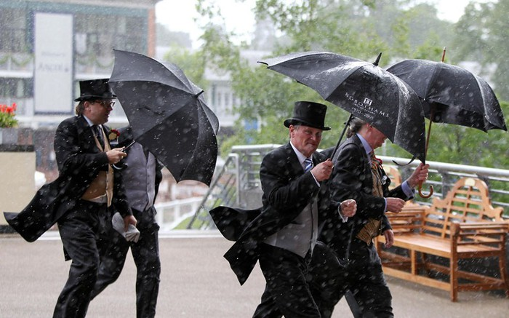
The weather in Great Britain is very changeable.
The English also say that they have three variants of weather:
when it rains in the morning, when it rains in the afternoon
or when it rains all day long.

Slide 14
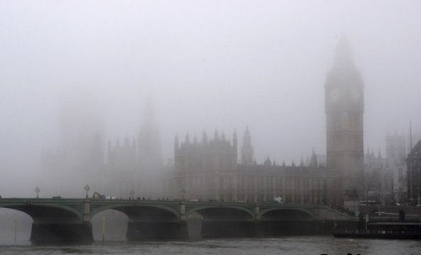
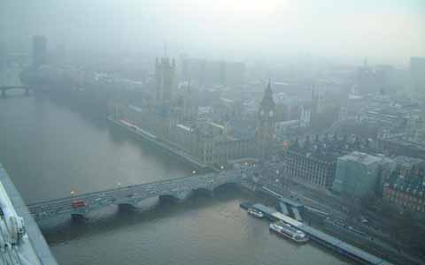
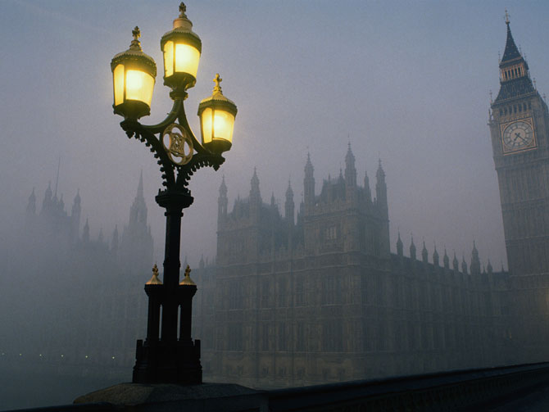
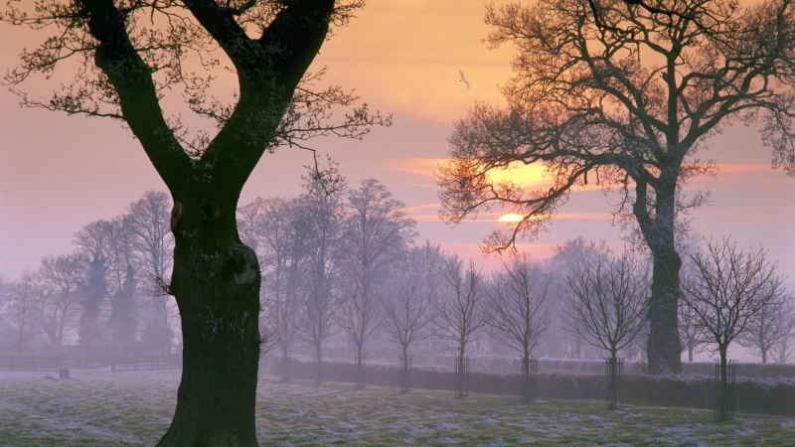
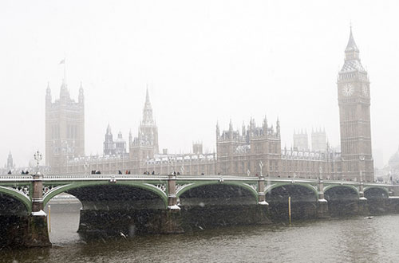
The most unpleasant aspect of English weather is fog and smog.

Slide 15
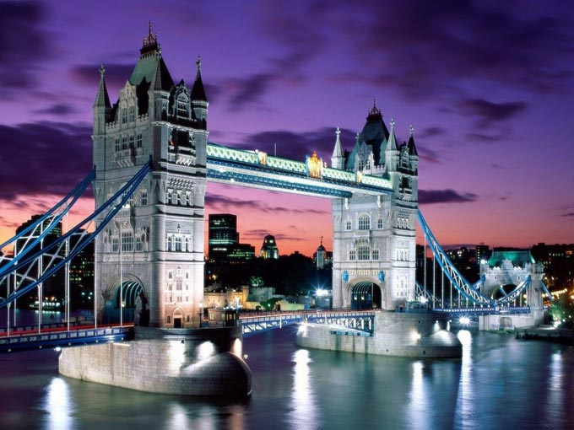
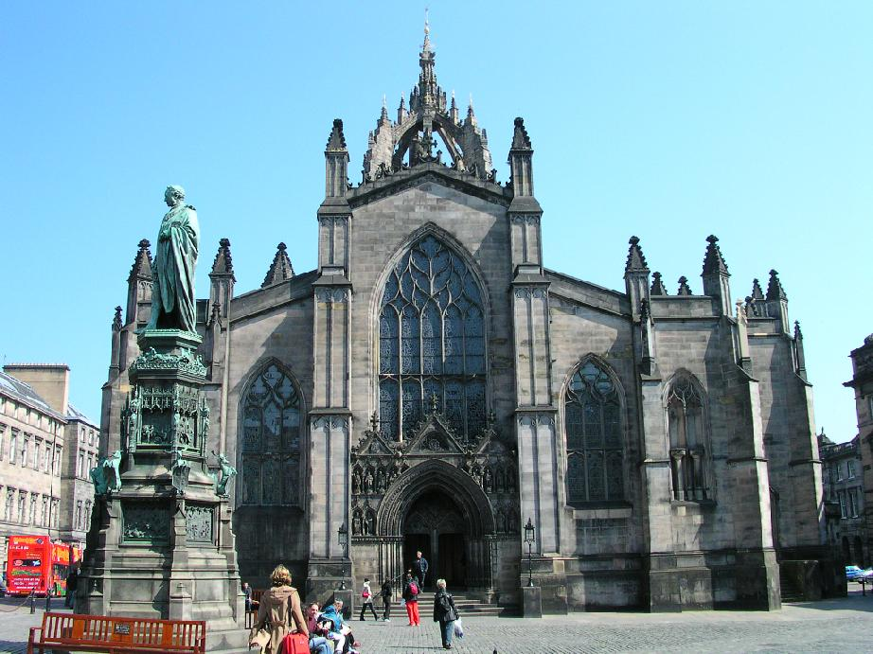
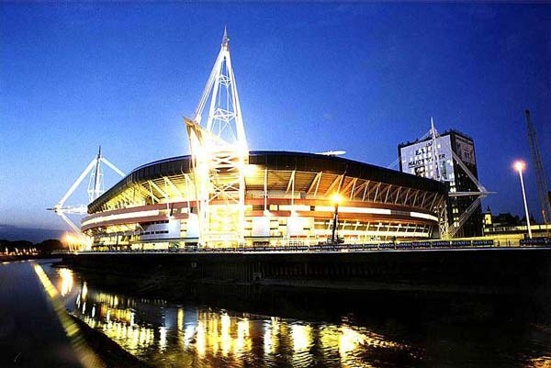
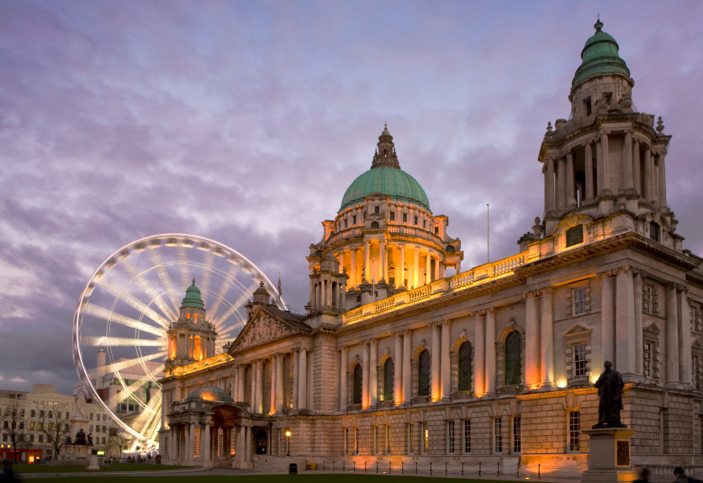
The capitals are: London in England , Edinburgh in Scotland , Cardiff in Wales and Belfast in Northern Ireland .

Slide 16
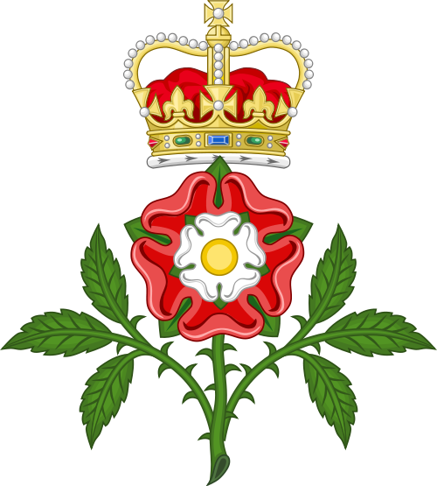
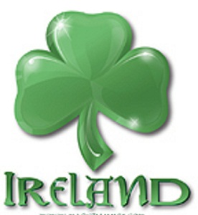
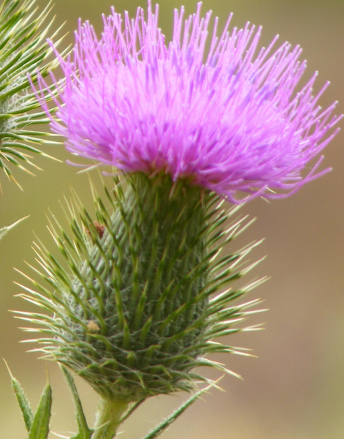
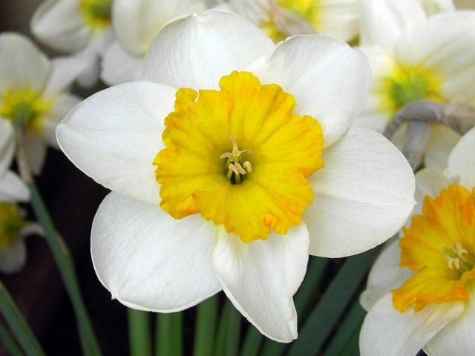
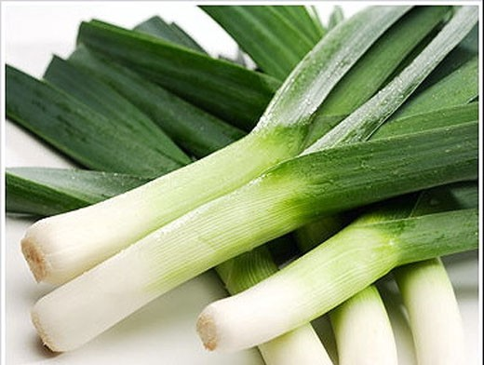
Every country has its own national emblem. The red rose is the national emblem of England. The thistle is the national emblem of Scotland. The daffodils and the leek are the emblems of Wales. The shamrock (a kind of clover) is the emblem of Ireland.

Slide 18
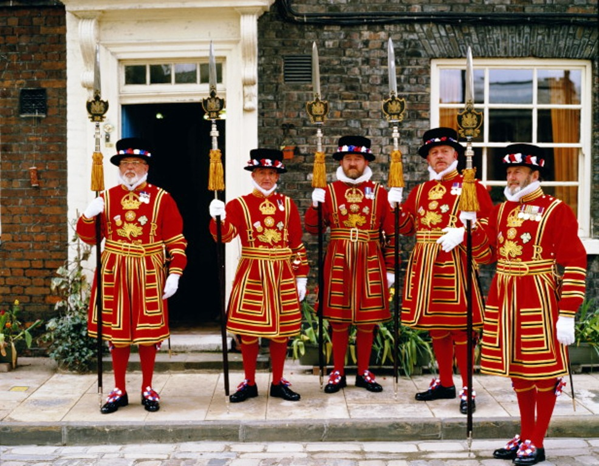
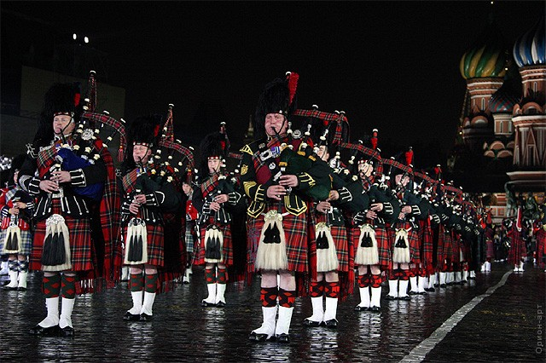
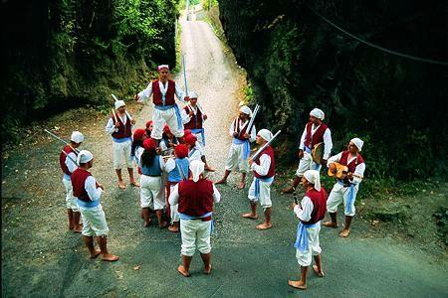
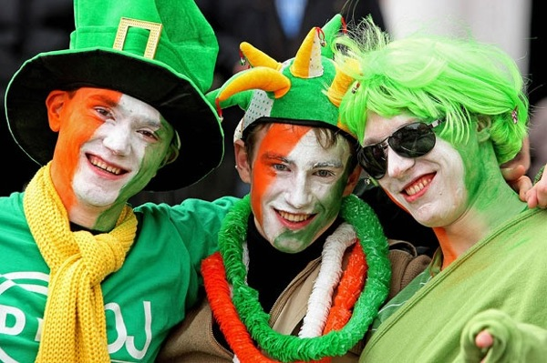
The population of the UK is over 58 mln people. The UK is inhabited by the English, the Scots, the Welsh and the Irish who constitute the British nation.

Slide 19
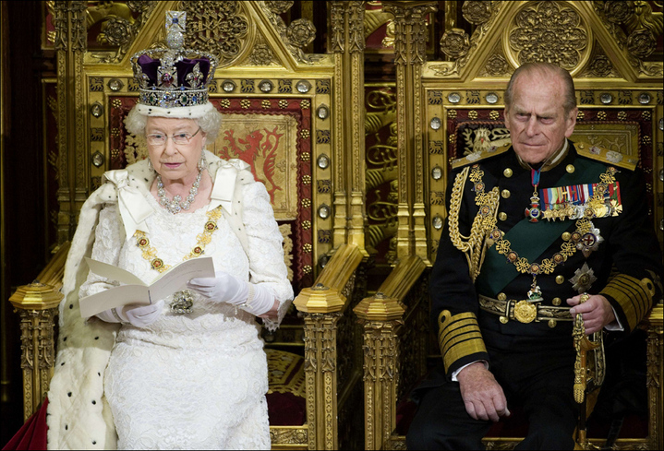
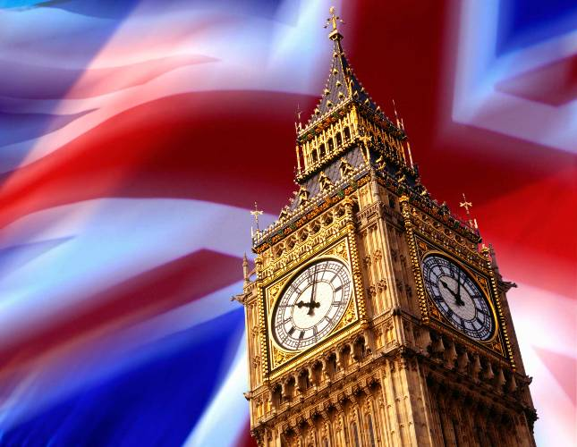
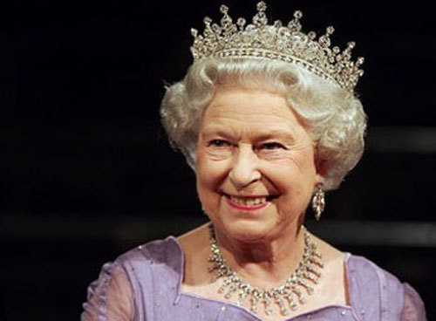
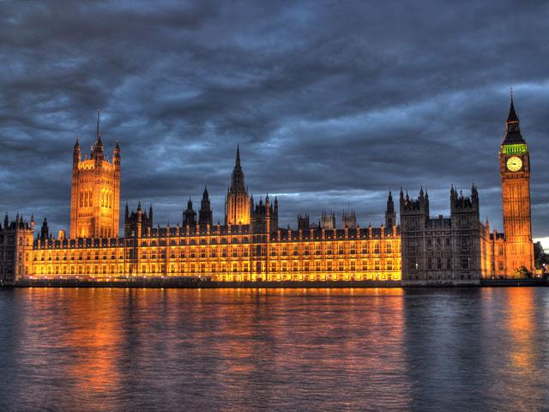
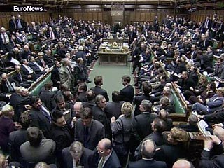
The UK is constitutional monarchy. In law, the Head of State is the Queen, but in practice, she does not rule. The country is ruled by the elected government with the Prime Minister . The British Parliament consists of two chambers: the House of Lords and the House of Commons.

