Slide 1
Welcome to our lesson!

Slide 2
Phonetic drill
Tongue twister
I thought a thought
But the thought I thought wasn’t the thought I thought I thought

Slide 3
Checking up the home task

Slide 4
Warm-up:
Let’s dance and dance

Slide 5
Today is the 18th of February
The theme of the lesson:
“Nature of Great Britain”

Slide 6
Bank with new words
fauna [fo:nə] фауна
flora [flo:rə]флора
oak [ouk] емен
mammal [mǽml]сүт қоректілер
pine [pain]қайың

Slide 7
About flora of Great Britain
There are large forested areas throughout England, adding a distinctive beauty to the landscape. The main tree species that inhabit both these forests and other natural areas include: Oak .Beech .Pine .Birch

Slide 8
Hills and mountains
This is a links page to the hills and mountains to be found in the United Kingdom (England, Northern Ireland, Scotland, and Wales), and includes lists of the highest mountains in each of the constituent countries.
The fifty six highest mountains in the UK are all to be found in Scotland, and so no single table for the UK's highest is given.

Slide 9
Popular river - The Thames
Among the most important rivers in the UK is the Thames, which flows into the North Sea. Its length is 346 km and it is the deepest river in Britain. It is navigable as far as the capital of Great Britain – London.

Slide 10
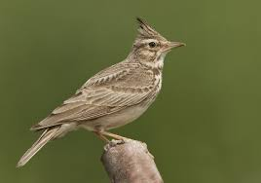
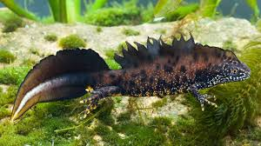
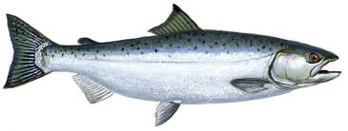
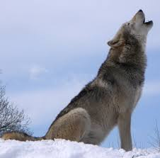
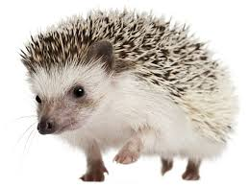
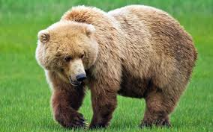
Fauna of Great Britain
Crested newt
Salmon
Crested Lark

Slide 11
To find adjectives from the text “Flora”
To find nouns from the text “Hills and mountains”
To find superlative adjective from the text
“The Thames”
To write 3 modal verbs

Slide 12
Role – play

Slide 13
Picture dictation.

Slide 14
Game
“4 pictures 1 word”

Slide 15
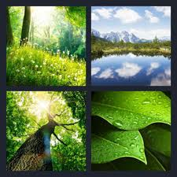

Slide 16
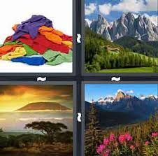

Slide 17
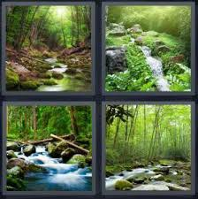

Slide 18
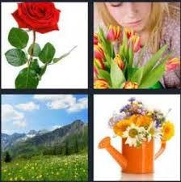

Slide 19
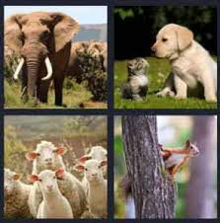

Slide 20
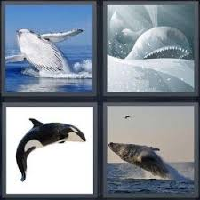

Slide 21
Conclusion
“Big washing”

Slide 22
Homework
To write topic about
nature of Beineu

Slide 23
